Slide 1
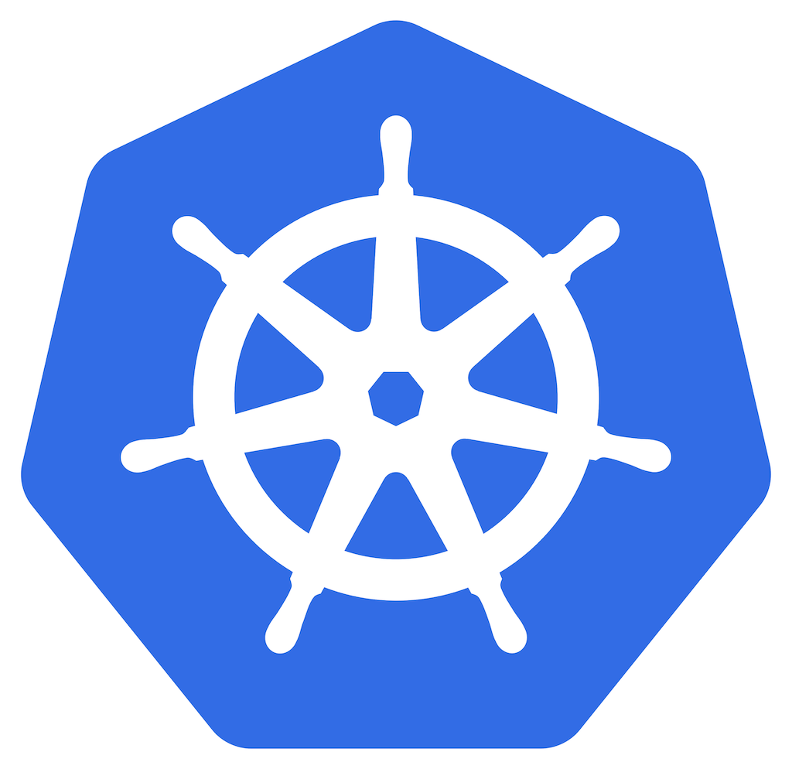
Kubernetes Training
Day 1
This Photo by Unknown Author is licensed under CC BY-SA

Slide 2
Topics(Day 1)
Docker Revision
Docker Compose
Container Runtime vs Container Orchestration
What is Kubernetes?
Why k8s come to existence?
K8s Offerings
Kubernetes downside
Kubernetes Architecture
Components flow Kubernetes
Kubernetes object models

Slide 3
Docker Compose
Issue
docker volume create soraf-vol
docker run -itd –name sorafc -p 18427:8427 -p 18443:8443 -v soraf-vol:/opt/Roamware/logs 172.16.129.152:8085/mobileum/soraf-ubi8-rel:Q220802
Solution
docker-compose.yaml file
“docker compose –f docker-compose.yaml up –d”

Slide 4
Container Runtime Vs Container Orchestration
It runs container image
It calls runc system function call to run container.
Example
Docker, Podman, CRI-o, Containerd etc
It monitor, deploy and manage containers
It uses Container runtime to run containers
Example
Docker swarm, Kubernetes, Nomad, AWS Elastic Kubernetes Service (EKS), Azure Container Instances

Slide 5
What is K8s
Kubernetes is a platform and container orchestration tool for automating deployment, scaling, and operations of application containers.
Originally Developed by Google, Written in Go Language
Kubernetes is Greek for "helmsman", your guide through unknown waters
Kubernetes is the linux kernel of distributed systems(Physical, Virtual, Cloud)
Kubernetes supports Docker, Containerd, CRI-O
Can manage 100 – 1000 Containers

Slide 6
Why k8s come to existence ?
Increase usage of containers.
Trends from monolithic to microservices.
Demand for the proper way to manage, deploy 1000s of container

Slide 7
K8s Offerings or feature
Addition to main docker advantages(scalability, isolation and Resource Utilization) it offer below
Self-healing
Restart, Replication
High Performance
Stability
Disaster recovery
Rollout /Roll-back
portable and cost-effective platform
An administrator can single-handedly manage and monitor

Slide 8
Kubernetes downside
The transition to Kubernetes can become slow, complicated, and challenging to manage.
Kubernetes has a steep learning curve.

Slide 9
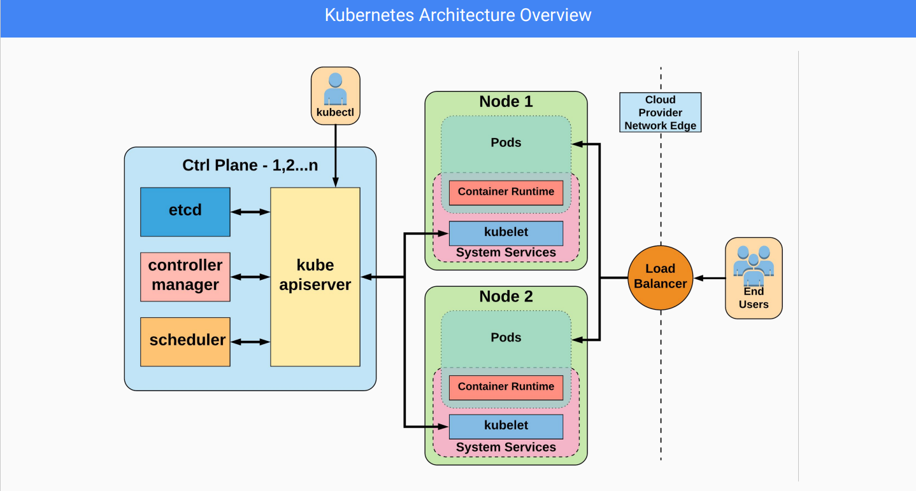

Slide 10
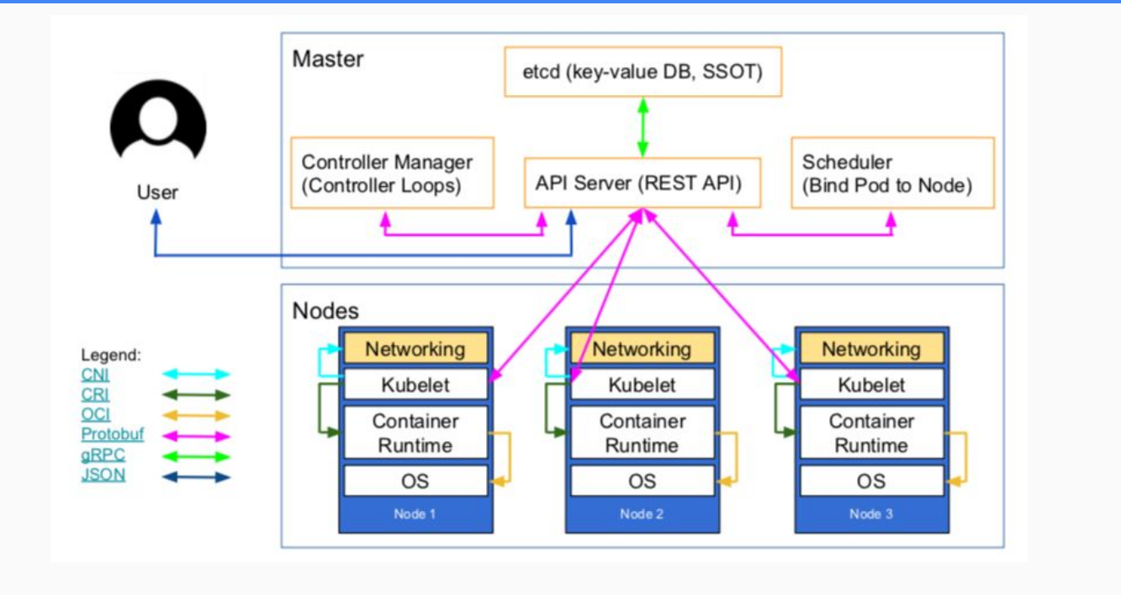
How all K8s Componunt communicate each other

Slide 11
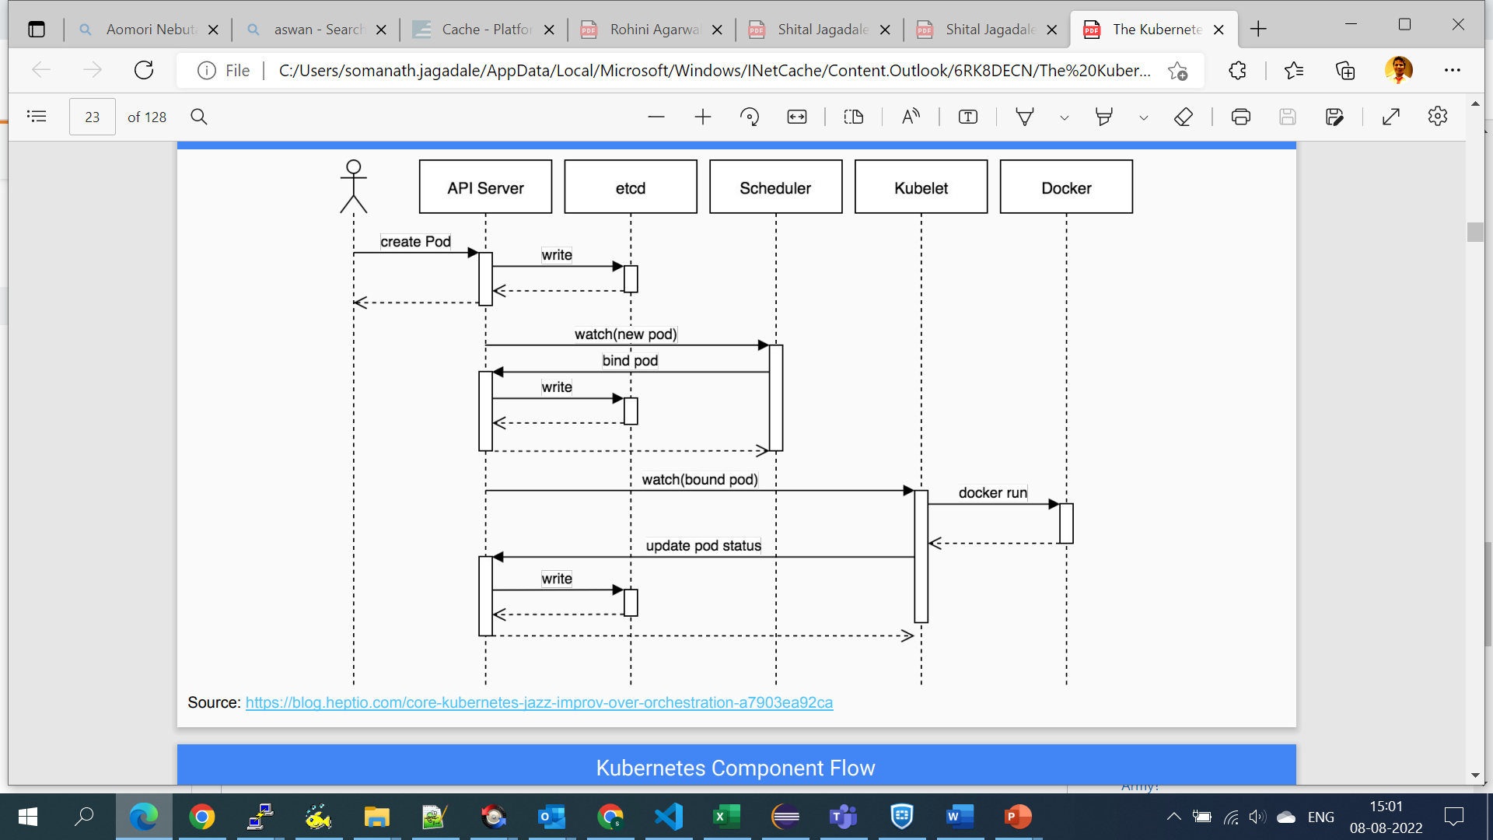
Kubernetes Components flow

Slide 12
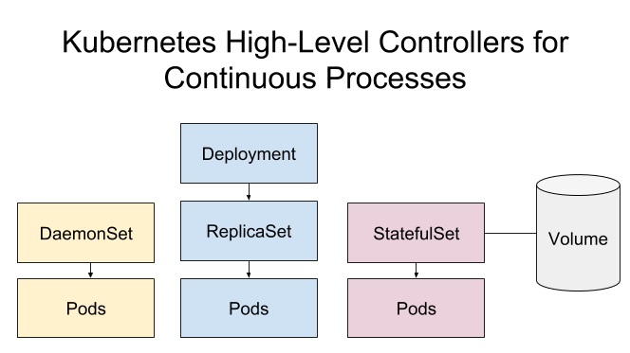
Kubernetes Objects/Resources Model

Slide 13
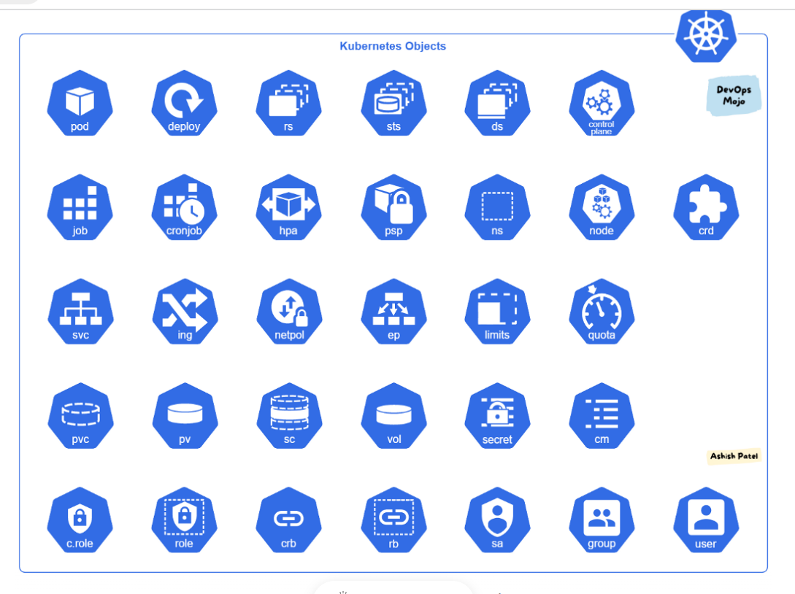

Slide 14
Pod
Smallest Unit or building block
Abstraction over Contianers
Usually one app/container per node
Each pod get its own IP address
Ephemeral Nature

Slide 15
Yaml file which create pod
apiVersion: v1 # Which version of the Kubernetes API you're using to create this object
kind: Pod # What kind of object you want to create
metadata: # Data that helps uniquely identify the object, including name and namespace
name: sompod-123 # name of pod
spec: # What state you desire for the object
containers:
- name: somc1 # name of container
image: alpine # image from docker hub
command: ["sh","-c","ping fb.com"] # starting process of container

Slide 16
K8s tools
Podman - Pod management tool
Podman is a daemonless, open source, Linux native tool designed to make it easy to find, run, build, share and deploy applications using Open Containers Initiative (OCI) Containers and Container Image
Minikube – Local Kubernetes setup on one machine
Minikube is a lightweight Kubernetes implementation that creates a VM on your local machine and deploys a simple cluster containing only one node
URL - https://minikube.sigs.k8s.io/docs/start/
URL - https://podman.io/getting-started/installation

Slide 17
Important commands
kubectl create -f pod.yaml
kubectl get pods
kubectl get po sompod-123 -o wide
kubectl logs sompod-123
kubectl exec -it sompod-123 – sh
kubectl describe pod abhipod-123
kubectl delete pod kostaspod-1
kubectl run sompod2 --image=nginx --port 80 --dry-run=client -o yaml
kubectl run sompod2 --image=nginx --port 80 --dry-run=client -o json >auto.json

